Slide 1
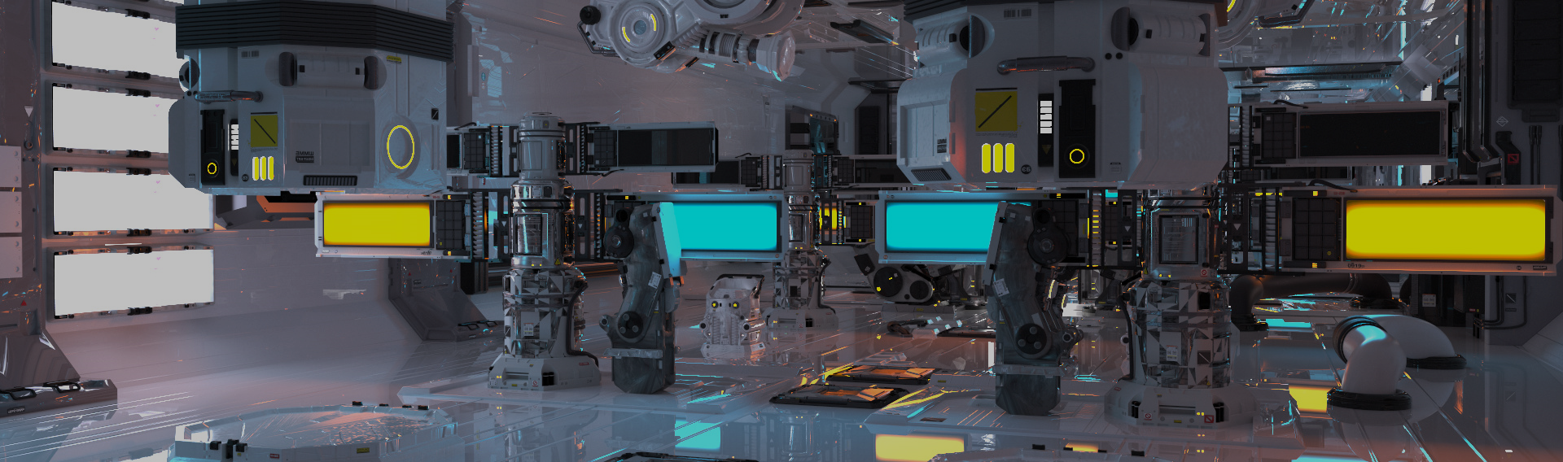
GPU Shader 2
電腦圖學導論實習
Information Technology Innovation | NTUST

Slide 2
Overview
Shader
Lighting
Classic Lighting Model
Modeling
Water surface
Wave
Animation

Slide 3
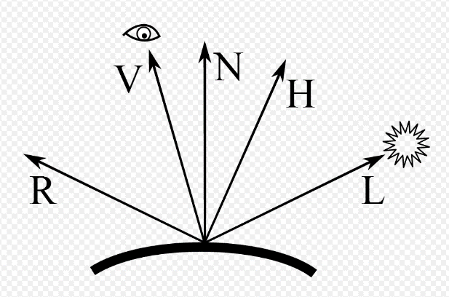
Illumination model
The position or direction of the light source allows us to calculate the brightness.
Reflection
Viewer
Normal
Half
Light
ψ
ψ
θ
θ

Slide 4
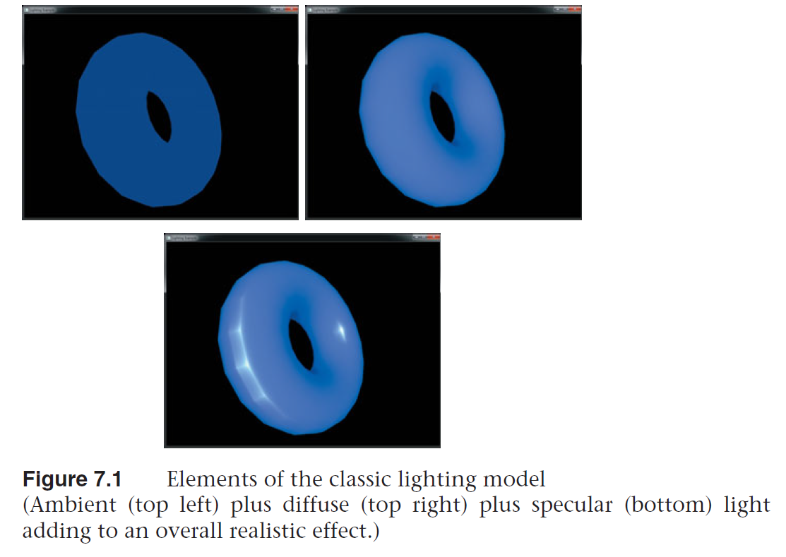
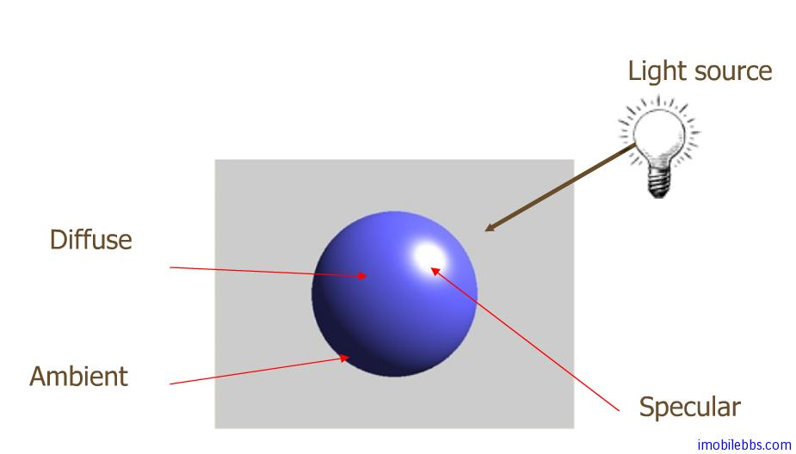
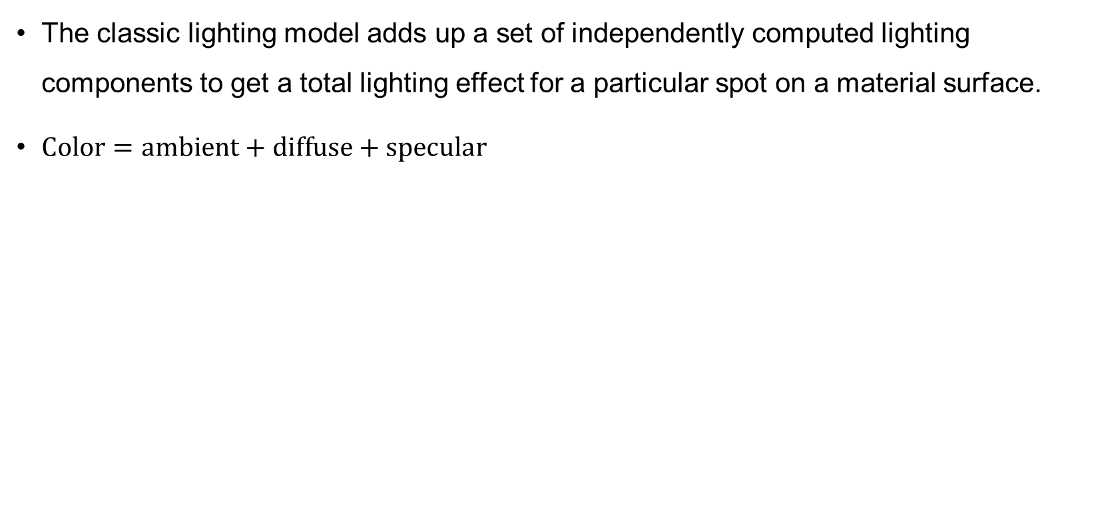
Classic Lighting Model
The classic lighting model adds up a set of independently computed lighting components to get a total lighting effect for a particular spot on a material surface.
$Color=ambient+diffuse+specular$

Slide 5
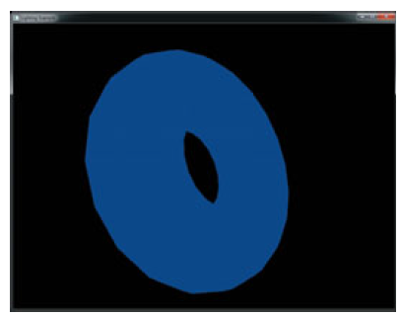
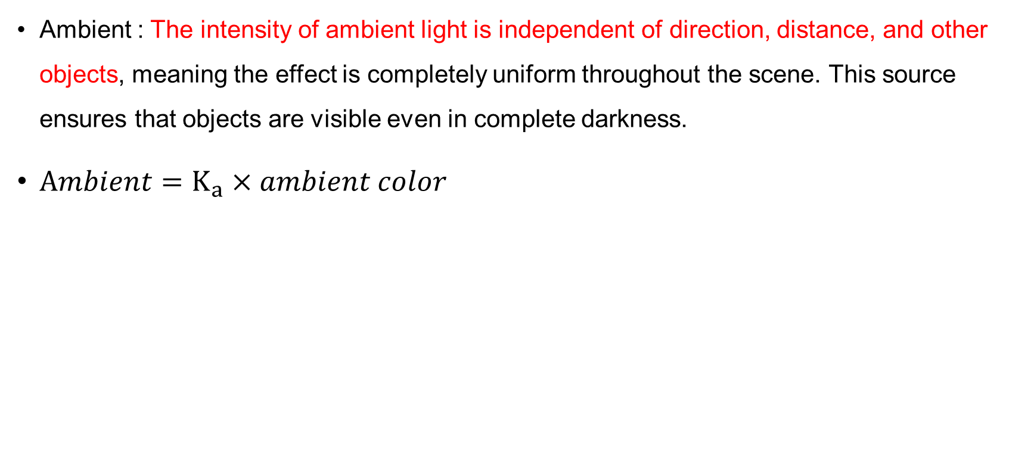
Ambient Term
Ambient : The intensity of ambient light is independent of direction, distance, and other objects, meaning the effect is completely uniform throughout the scene. This source ensures that objects are visible even in complete darkness.
$Ambient=K_{a}×ambient color$

Slide 6
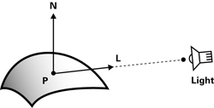
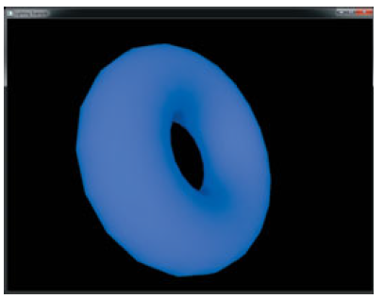
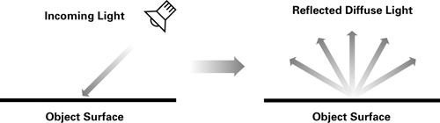
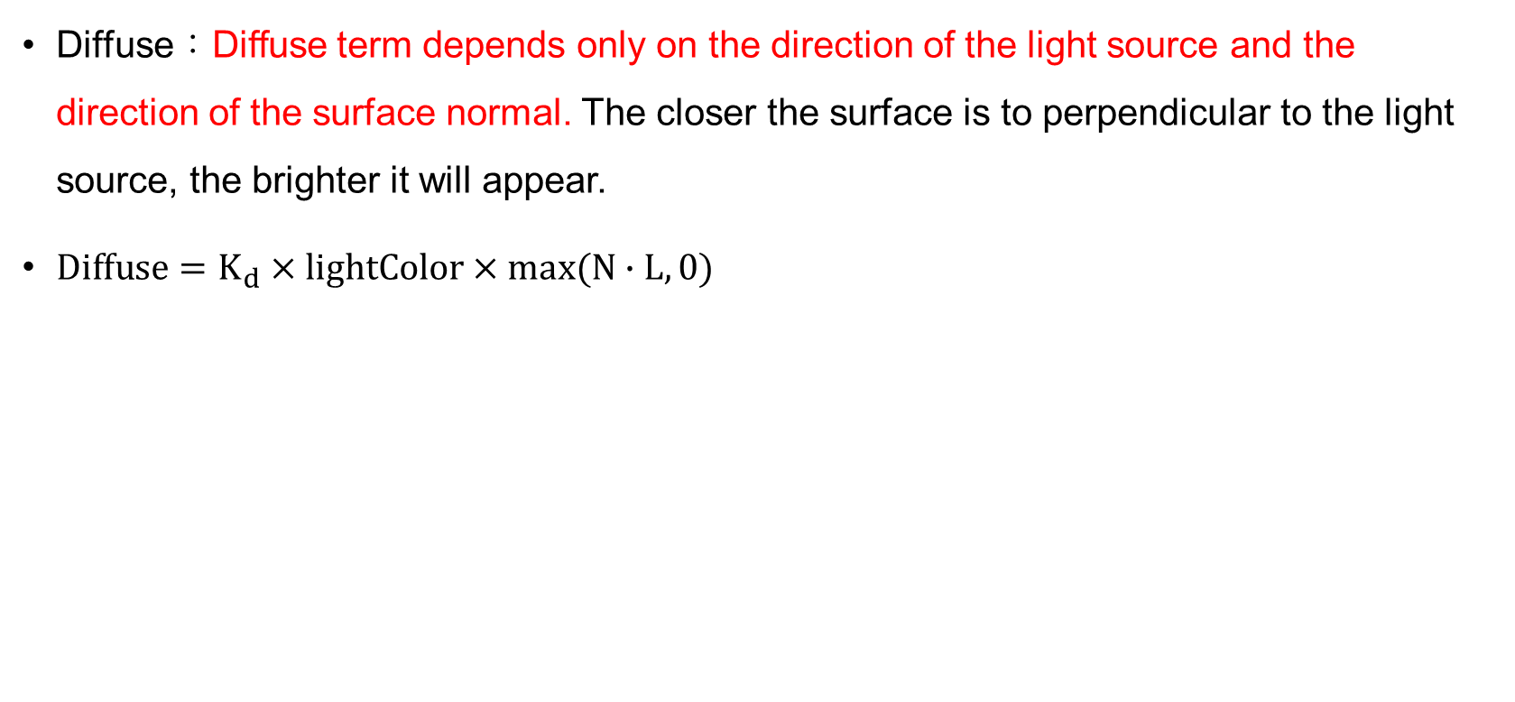
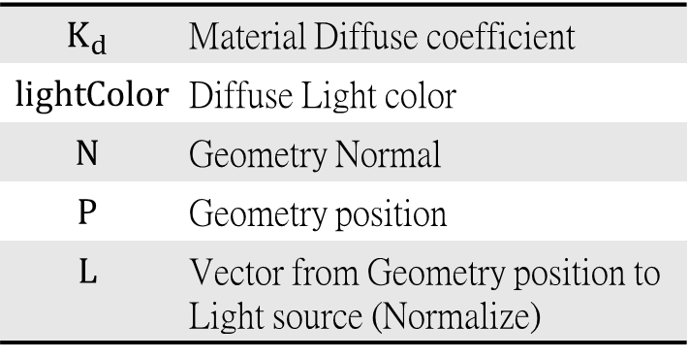
Diffuse Term
Diffuse：Diffuse term depends only on the direction of the light source and the direction of the surface normal. The closer the surface is to perpendicular to the light source, the brighter it will appear.
$Diffuse=K_{d}×lightColor×max(N∙L, 0)$
$$K_{d}$$ | Material Diffuse coefficient
$$lightColor$$ | Diffuse Light color
$$N$$ | Geometry Normal
$$P$$ | Geometry position
$$L$$ | Vector from Geometry position to Light source (Normalize)

Slide 7
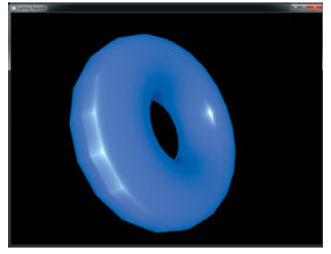
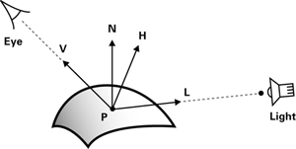
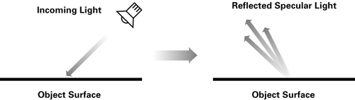
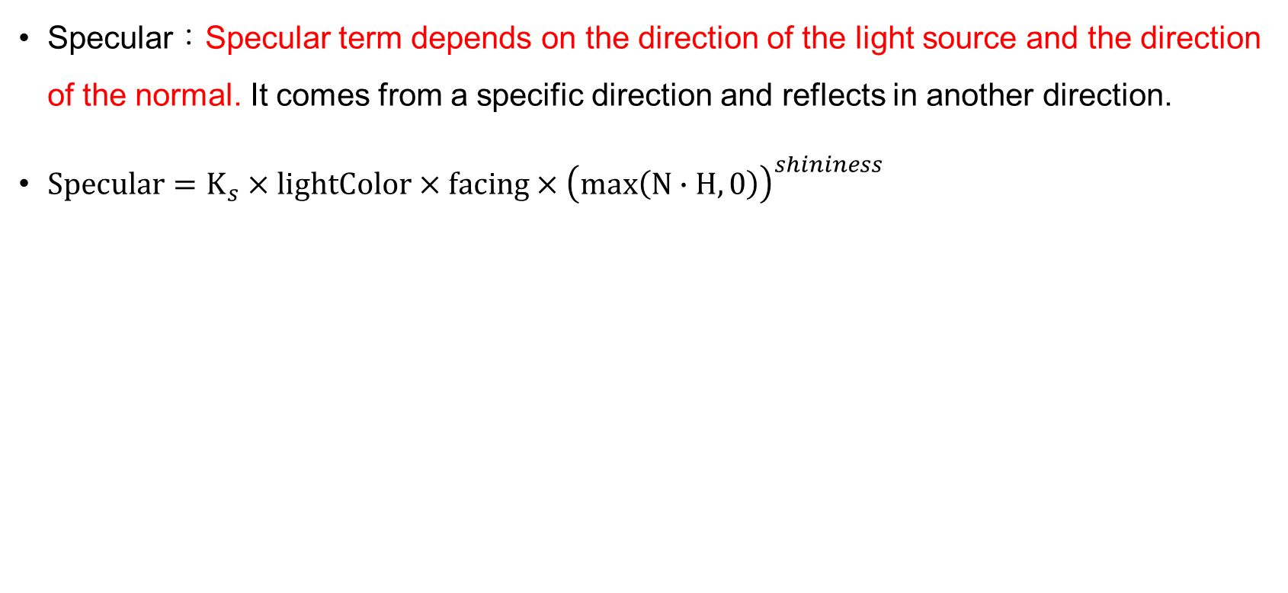
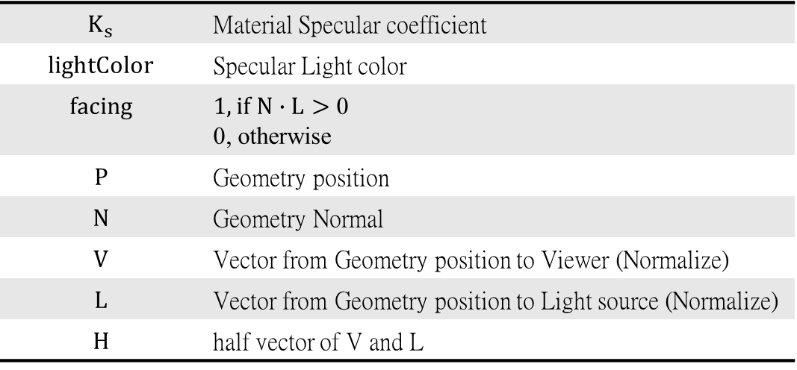
Specular Term
Specular：Specular term depends on the direction of the light source and the direction of the normal. It comes from a specific direction and reflects in another direction.
$Specular=K_{s}×lightColor×facing×{\left(max\left(N∙H, 0\right)\right)}^{shininess}$
$$K_{s}$$ | Material Specular coefficient
$$lightColor$$ | Specular Light color
$$facing$$ | $1, if N∙L>$ 0 0, otherwise
$$P$$ | Geometry position
$$N$$ | Geometry Normal
$$V$$ | Vector from Geometry position to Viewer (Normalize)
$$L$$ | Vector from Geometry position to Light source (Normalize)
$$H$$ | half vector of V and L

Slide 8
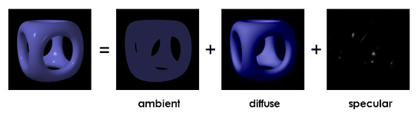
ADS model

Slide 9
Vertex Shader
#Version 430 core
uniform mat4 model_matrix;
uniform mat4 proj_matrix;
Layout (location = 0) in vec4 position;
Layout (location = 1) in vec3 normal;
out vec3 vs_worldpos;
out vec3 vs_normal;
void main(void){
vec4 pos = proj_matrix * model_matrix * position;
gl_Position = pos;
vs_worldpos = pos.xyz;
vs_normal = normalize(mat3(model_matrix) * normal);
}
Transform to display plane
Get Normal

Slide 10
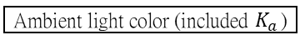
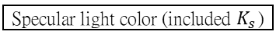
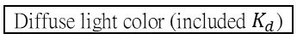
Fragment Shader
#Version 430 core
Layout (location = 0) out vec4 out_color;
in vec3 vs_worldpos;
in vec3 vs_normal;
uniform vec4 color_ambient = vec4(0.1, 0.2, 0.5, 1.0);
uniform vec4 color_diffuse = vec4(0.2, 0.3, 0.6, 1.0);
uniform vec4 color_specular = vec4(1.0, 1.0, 1.0, 1.0);
uniform vec4 color = vec4(0.1, 0.1, 0.5, 1.0);
uniform float shininess = 77.0f;
uniform vec3 light_position = vec3(50.0f, 32.0f, 560.0f);
uniform vec3 EyeDirection = vec3(0.0, 0.0, 1.0);
void main(void){
vec3 light_direction = light_position – vc_worldpos;
vec3 half_vector = normalize(normalize(light_direction) + normalize(EyeDirection));
float diffuse = max(0.0, dot(vs_normal, light_direction));
float specular = pow(max(0.0, dot(vs_normal, half_vector)), shininess);
out_color = min(color * color_ambient, vec4(1.0)) + diffuse * color_diffuse + specular * color_specular;
}
Ambient light color (included $K_{a}$)
Diffuse light color (included $K_{d}$)
Specular light color (included $K_{s}$)
Object color
Specular reflection intensity
Get L
Get H
Diffuse term
Specular term
Final color

Slide 11
Water surface
Low-level surface details
small scale perturbation
normal map
pixel shader
High-level surface structure
large scales of the wave movement
a set of 2D grid with the y direction
Height map
vertex shader: change the normal and the y position of the vertex

Slide 12
Wave
Calculate the position of each vertex on the horizontal plane, then calculate the y-coordinate of each vertex.

Slide 13
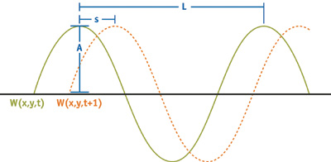
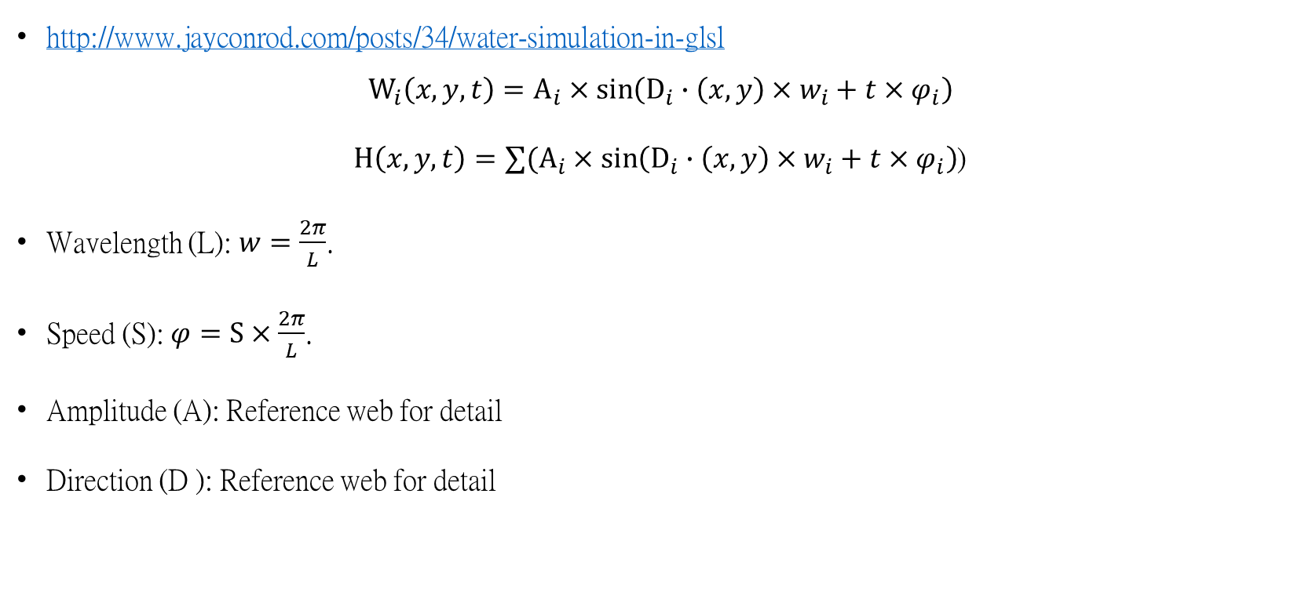
Sin Wave
http://www.jayconrod.com/posts/34/water-simulation-in-glsl
$$W_{i}\left(x, y, t\right)=A_{i}×\sin\left(D_{i}∙\left(x, y\right)×w_{i}+t×φ_{i}\right)$$
$H\left(x, y, t\right)=∑(A_{i}×\sin\left(D_{i}∙\left(x, y\right)×w_{i}+t×φ_{i}\right)$)
Wavelength (L): $w=\frac{2π}{L}$.
Speed (S): $φ=S×\frac{2π}{L}$.
Amplitude (A): Reference web for detail
Direction (D ): Reference web for detail

Slide 14
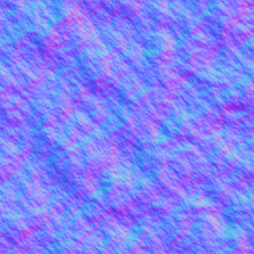
Height map
The existing wave image will be used as a height map to calculate the vertex height. The sample points will be shifted over time.
https://www.shadertoy.com/view/tdSSWz

Slide 15
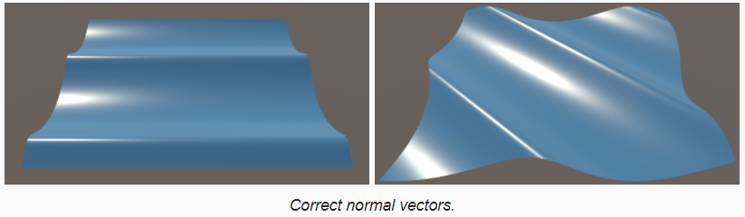
Hw10(8%)
Shading wave with shader (Sin wave Refer （Not using GLSL）
Position, Normal(3%)
Lighting(2%)
Animation(2%)

Slide 16
Water Surface Rendering
Reflection
Refraction
Combination of refraction and reflection with an environment map for the sky and a set of texture map for the box.
Using the refraction map and reflection map to simulate the possible viewing condition from above the water to simulate the refraction and reflection effects.

Slide 17
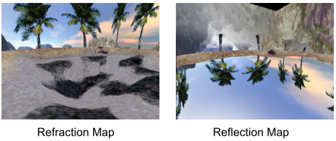
Water Surface Rendering

Slide 18
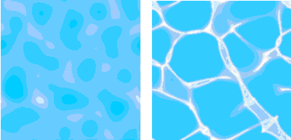
Water Surface Rendering

Slide 19
Vertex Shader
vec4 Vpos = gl_ModelViewMatrix * gl_Vertex;
vec3 pos = Vpos.xyz / Vpos.w;
vec3 norm = normalize(gl_NormalMatrix * gl_Normal);
vec3 InVec = normalize(pos - eyepos.xyz); // V vector
RefractVec = refract(InVec, norm, Eta);//Eta:Refractive index = 0.66
ReflectVec = reflect(InVec, norm);

Slide 20
Fragment Shader
vec4 basecolor = tex2D(WaterTex,gl_TexCoord[1].xy);
vec3 ReflectColor = vec3(textureCube(WaterCube, ReflectVec));
vec3 RefractColor = vec3(textureCube(WaterCube, RefractVec));
vec3 outputCol = mix(RefractColor, ReflectColor, Ratio);
gl_FragColor = vec4( outputCol * basecolor , 1.0 );

